Slide 1



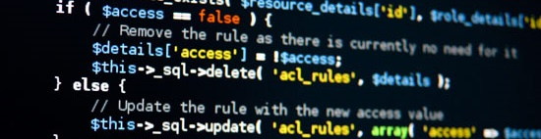
PHP Basics
Course Introduction
SoftUni Team
Technical Trainers
Software University
http://softuni.bg

Slide 2


Table of Contents
Course Objectives
Course Program
Trainers Team
Examination
Learning Resources

Slide 3
Level #1 at the Software University
Java Basics
6 times + TW + labs + exam
4 weeks * 2 times
Web Fundamentals (HTML + CSS)
10 times + TW + labs + exam
4 weeks * 3 times
JavaScript Basics
6 times + TW + labs + exam
4 weeks * 2 times
PHP Basics
6 times + TW + labs + exam
4 weeks * 2 times
Teamwork and Personal Skills
4 times
16 weeks * 1 times
Teamwork and Personal Skills (Part II)
6 times

Slide 4

PHP Basics
Course Objectives & Program

Slide 5
PHP Basics – Course Program
Course Introduction – Course Program, Exams, Trainers, Evaluation… XAMPP/WAMP/LAMP, PHP IDEs – PHP, CGI, Web server, Running PHP Scripts
PHP Syntax – Syntax, data types, variables, operators, expressions…
Working with Forms – GET, POST, HTML escaping, query strings, checkboxes, hidden fields, other input types, URL redirecting, sessions
Using Regex – Practical workshop on using Regex in PHP and other languages
PHP Flow Control – Conditionals, loops, functions, exit, return, require, try…catch, declare

Slide 6


PHP Basics – Course Program (2)
Arrays, Strings and Objects – Arrays, associative arrays, strings, objects
Working with MySQL – Using MySQL database and working in PHP
PHP & MySQL – Practical workshop on creating end-to-end Web applications with PHP and MySQL
Exam Preparation
Teamwork Defense
Practical Exam

Slide 7


Warning: Not for Absolute Beginners
The “PHP Basics" course is NOT for absolute beginners
Take the "C# Basics" course at SoftUni first: https://softuni.bg/courses/csharp-basics
The course is for beginners, but requires previous coding skills
Requirements
Coding skills – entry level
Computer English – entry level
Logical thinking
coding skills
required!

Slide 8

The Trainers Team

Slide 9
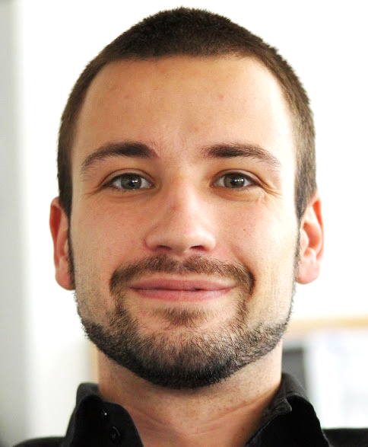
Trainers Team
Angel Georgiev
Part time trainer @ SoftUni
Top performing student from the Software University (2014)
8 years experience as Trainer in companies like Sony Ericsson, Samsung & Sony

Slide 10
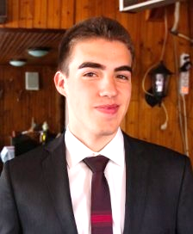
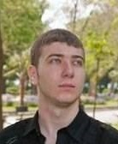
Trainers Team (2)
Nikolay Bankin
Top performing student from the Software University (2014)
Software Engineer at Obecto
Ivan Yonkov
Top performing student from the Software University (2014)
3 Years of programming experience mainly with Java and PHP

Slide 11

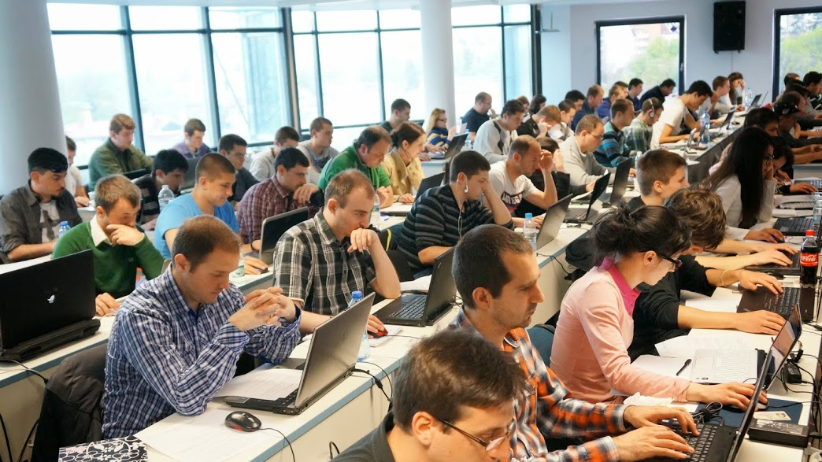
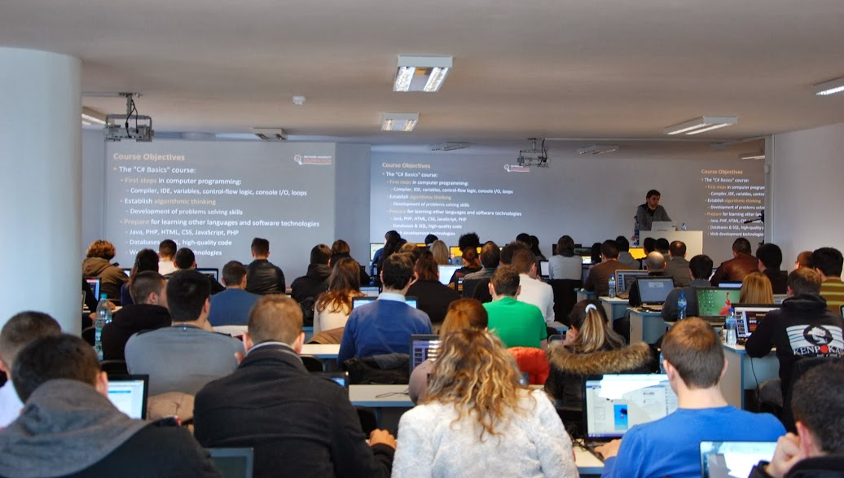
Volunteer Teaching Assistants
Volunteer teaching assistants
Developers from the software industry
Scholarship students from SoftUni

Slide 12

PHP Basics: More Details
Duration, Languages, Technologies

Slide 13


Training Duration – PHP Basics
Lectures: ~ 12 hours (onsite + YouTube videos)
Practical exercises (in class): ~ 12 hours
Homework: ~ 30-50 hours
Team project: ~ 10-20 hours
Exam preparation: 8 hours
Exam: 6 hours
Schedule: April 2015
Teamwork defense dates: 28 April 2015
Exam date: 3 May 2015

Slide 14
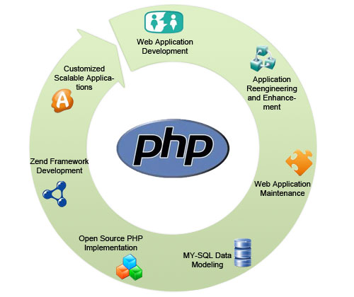
Why PHP?
Understand how the Web really works
PHP codes runs fast because it runs in its own memory space
You have thousands of PHP applications to choose from
Facebook, Twitter, Wikipedia, WordPress, Drupal, Joomla…
You can use PHP to extend existing applications
PHP is the most widely used server-side programming language.
PHP is open source (freely available for use)
PHP is platform independent
Supports all major web servers

Slide 15



Why English?
Why the slides are in English?
English is the native language of the software engineers
Specific terminology should be in English
Translations are inaccurate and funny
Just learn English!
No excuses

Slide 16



PHP Basics
Evaluation Criteria

Slide 17


Scoring System for the "PHP Basics"
Exam – 80%
Homework + evaluation – 5% + 5%
Team work: 10%
Bonuses: up to 10%
Presence in class (onsite students only)
Forum bonuses
Others

Slide 18
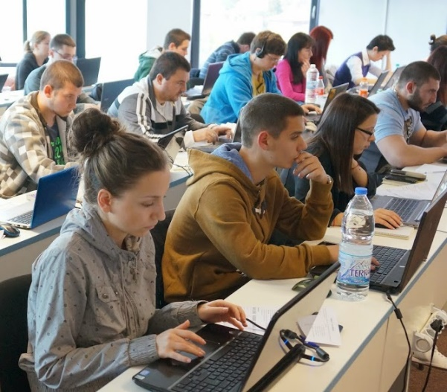

PHP Practical Exam
4 practical problems for 5 hours
Loops – Input with forms
Strings – Input with forms, HTML output
Forms validation – Input with forms, JSON output
Associative arrays – JSON input, JSON output
You should code in PHP
Automated judge system with real-time feedback
http://judge.softuni.bg
Solutions are evaluated for correctness only
Code quality is still not measured

Slide 19

Homework Assignments
Doing your homework is very important!
Programming can only be learned through a lot of practice!
You should write code every day!
Each lecture is followed by a few exercises
Try to solve them in class
The rest are your homework
Homework assignments are due in 1 week after each lecture
Submission will be accepted through our web site: softuni.bg

Slide 20

Homework Peer Reviews
Give feedback to a few random homework submissions
Students submit homework anonymously
Please exclude your name from the submissions!
For each homework submitted
Students evaluate 3 random homeworks
From the same topic, after the deadline
Give written feedback, at least 200 characters
Low-quality feedback → report for punishment
Everyone will get feedback for their homework

Slide 21









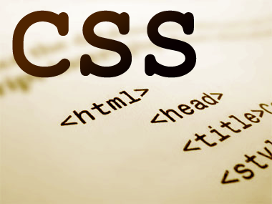
Resources
What We Need Additionally?

Slide 22

Course Web Site & Forums
The PHP Basics official web site:
Register for the "Software University Forum":
Discuss the course exercises with your colleagues
Find solutions for all course exercises
Share source code / discuss ideas / help each other
https://softuni.bg/courses/php-basics/
https://softuni.bg/forum

Slide 23



PHP Basics Slides and Videos
All lecture slides, videos, homework assignments, projects and other resources are open content, available for free
Visit the course web site to access the course resources

Slide 24



PHP Resources
PHP Official Site and Documentation
http://php.net
PHP Books
Programming PHP
PHP and MySQL Web Development
Beginning PHP5, Apache, MySQL Web Development

Slide 25
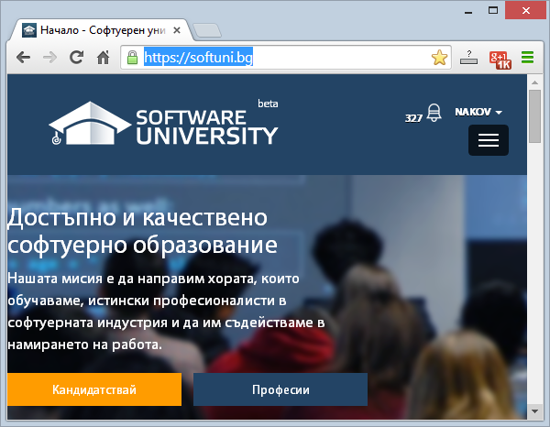
Software University Learning System (SULS)
Software University Learning System (SULS)
www.softuni.bg
Important resource for students
Homework submissions
Homework check-up
Exams and results
Reports about your progress
…

Slide 26









PHP Basics – Course Intro
https://softuni.bg/courses/php-basics/

Slide 27
License
This course (slides, examples, demos, videos, homework, etc.) is licensed under the "Creative Commons Attribution-NonCommercial-ShareAlike 4.0 International" license
Attribution: this work may contain portions from
“PHP/MySQL" course by SoftUni under CC-BY-NC-SA license

Slide 28





Free Trainings @ Software University
Software University Foundation – softuni.org
Software University – High-Quality Education, Profession and Job for Software Developers
softuni.bg
Software University @ Facebook
facebook.com/SoftwareUniversity
Software University @ YouTube
youtube.com/SoftwareUniversity
Software University Forums – forum.softuni.bg

